Slide 1
A little Bit of History – Before Databases
  Introduction to Database Systems
  Chapter 1 & 2
  Carlos Coronel, Steven Morris - Database Systems: Design, Implementation & Management, 13th edition, CENGAGE Learning, 2019, ISBN-13: 978-1337627900.
Database Systems
Robert Dollinger 2021

Slide 2
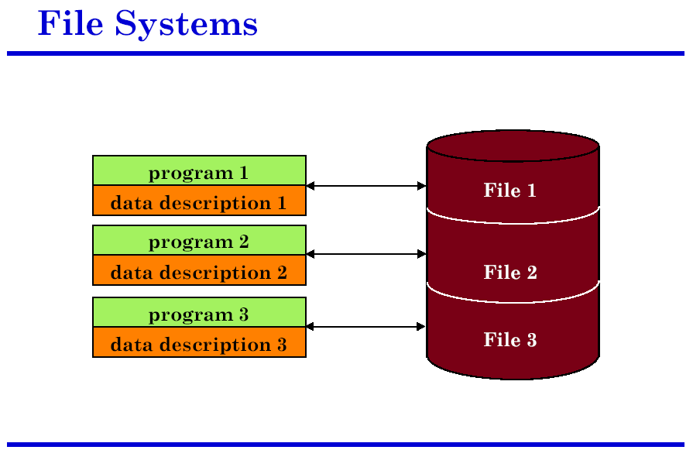
A little Bit of History – Before Databases
  -
Database Systems
Robert Dollinger 2021

Slide 3
A little Bit of History – Before Databases
  -
Problems:
each user has its own data files;
some data may be duplicated among several users;
data inconsistencies;
difficult maintenance;
only individual access;
data is not correlated;
easy corruption of data, lack of meaningful constraints.
Database Systems
Robert Dollinger 2021

Slide 4
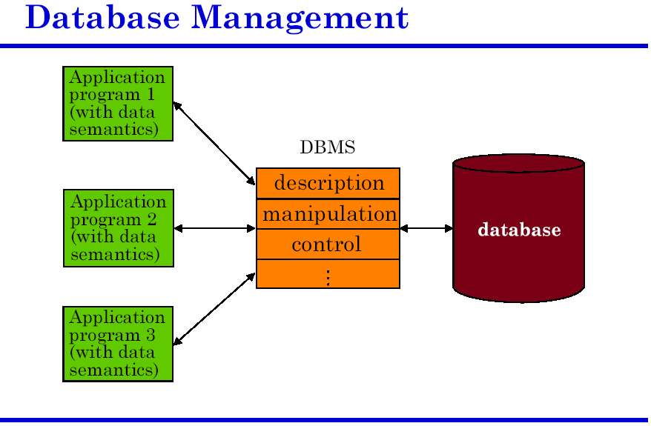
Database System
  -
Database Systems
Robert Dollinger 2021

Slide 5
Database System
Advantages:
integration of data;
data sharing among several users;
concurrent access and transactional support;
data protection and consistency;
use of meaningful constraints on data;
“data services”.
  -
Database Systems
Robert Dollinger 2021

Slide 6
Basic Concepts
  Data – representations of facts from the real world.
  Database – organized/structured collection of data.
  Database Management System (DBMS) - software tool to manage the database.
  Database systems consist of multiple elements and are inherently complex in terms of data structures, functionality and interactions.
  In order to make the database systems more efficient, flexible and manageable, and reduce the complexity to the users such systems are designed and built on 3 levels of data abstraction: physical, conceptual and external level.
  -
Database Systems
Robert Dollinger 2021

Slide 7
Levels of data abstraction
  There are 3 levels of data abstraction in a database system:
  Physical level – deals with how data is organized and managed at level of the hardware storage. It is the lower level-infrastructure of the database system. It includes elements such as: file system, data blocks, indexes.
  Conceptual level – deals with how data is organized, managed and accessed at the database level. Provides the global data view based on a data model. It is a comprehensive representation of the how the data is structured and organized. It is where the DBA is in control and exercises her skills.
  External level – deals with how data is exposed to and is seen by the end users. Provides an individualized, partial view of the database serving the needs of various user groups.
  -
Database Systems
Robert Dollinger 2021

Slide 8
Data Independence
  Data independence – the physical, conceptual and external levels are independent from each other.
  Data independence makes database systems more flexible and manageable, while providing simplicity to the end users.
  Types/levels of data independence:
    1. Physical data independence – the way data is organized on the storage does not influence the conceptual level.
    2. Logical data independence – changes at the conceptual level are transparent at the external level.
Database Systems
Robert Dollinger 2021

Slide 9
Data Model
  Data represent facts of the real world.
  Data models organize data elements and, standardize how the data elements relate to one another and how they can be manipulated:
  Data Model=Set of Rules for Organizing Data +
  Set of Rules for Manipulating Data
  The role of a data model is to represent reality: people, places, objects, business processes and the events between them.
  The data model is only a representation of reality, created through an abstraction process, which is driven by the relevance criterion towards a given purpose (expressed as a set of requirements).
  In other words, the data model will represent only what is relevant and useful to achieve the given purpose. Anything else is ignored in the abstraction process according to the relevance criterion.
Database Systems
Robert Dollinger 2021

Slide 10
Data Model
  Various data models use different building blocks and apply different sets of rules on how to structure and manipulate data.
  In database design we use data models that represent reality in terms of Entities and Relationships between entities. Such data models are simple and highly abstract.
  Entities are modeled as a composition of their properties, called attributes.
  Relationships connect one or more entities and can have their own attributes.
  Comment:
  Data models used in data warehousing are expressed in terms of entities, relationships and hierarchies across the attributes of an entity.
  UML – Universal Modelling Language represents reality as a network of objects, where the basic building blocks of the model are entities, relationships and behavior.
Database Systems
Robert Dollinger 2021

Slide 11
Data Model
A Data Model is materialized in the following components of the database management system:
  Data Definition Language (DDL) – defines the structures recognized in the given data model as well as constraints, that structures forbidden by the data model.
Ex. SQL CREATE TABLE phrases and foreign key constraint definitions.
  Data Manipulation Language (DML) – defines operations accepted in the data model.
Ex. INSERT, UPDATE and DELETE operations.
Consequence:
Due to their conceptual simplicity, data models are so general that just above anything, any aspect of the real world, can be captured into a data model.
Database Systems
Robert Dollinger 2021

Slide 12
Data Models
  Data models used to implement operational databases:
  Hierarchic Data Model – organizes data as a tree; very efficient, but with limited possibilities;
  Network Data Model – organizes data as a network; efficient, but difficult to program and use;
  Relational Data Model – organizes data in flat tables; fairly efficient and easy to program; can be used even by non-professionals;
  OO Data Model(s) – looking for a compromise between OO features on one side, and simplicity, efficiency and know-how of other data models on the other hand;
  Semantic Data Models (E/R Data Model) – mostly design tools, high level of abstraction.
Database Systems
Robert Dollinger 2021

Slide 13
Data Storage Options in the Enterprise Data Infrastructure
  Several layers of data storage options are available when developing the overall architecture of an Enterprise Data Infrastructure:
  Operational Database – also called on-line transactional processing databases (OLTP systems), are databases that support and serve the need of day-to-day operations of an enterprise. Characterized by frequent read and write operations performed simultaneously by multiple users. Concurrency control and operation logs are important.
  Data Warehouse (Data Mart) – is a consolidated, structured repository that stores historical data for the purposes of data analysis that support strategic decision making.
  Data Vault – is a historical storage of raw data designed to support data analysis and strategic decision making under changing business requirements.
  Data Lake - is a repository of raw data, stored in native format, for the purposes of future uses.
Database Systems
Robert Dollinger 2021

Slide 14
  Data Management Principles
  Data management systems fall in one of two categories:
Schema-on-write Systems – require a schema to be created before loading the data. Traditional operational databases, data marts and data warehouses fall in this category. The data needs to be structured and transformed to fit into the defined schema and it serves as the “single version of truth”.
Schema-on-read Systems - do not require a schema before loading the data. The data is stored with minimum structure or no structure at all, as it comes from the sources, and it serves as the “single version of facts”. The essential schema is applied during the query phase when the data gets to be used. Data vaults and data lakes fall into this category.
Database Systems
Robert Dollinger 2021

Slide 15
  Data Management Principles
  Schema-on-read and Schema-on-write Processes
Collect Data
(Extract)
Write Data
(Load)
Apply Schema
(Transform)
Analyze
Schema-on-read
Apply Schema
(Transform)
Analyze
Apply Schema
(Transform)
Analyze
Apply Schema
(Transform)
Write Data
(Load)
Analyze
Schema-on-write
Analyze
Analyze
Database Systems
Robert Dollinger 2021

Slide 16
  Data Management Principles
  Characteristics of schema-on-write:
  Data goes through and ETL process, i.e. the data is Extracted from the sources, Transformed to match the given schema, and Loaded into the data storage (Data Warehouse).
  Provides only one view on the data, as captured by the schema (“single version of truth”) and lacks agility in supporting diverse types of analysis.
  The ETL process is long, tedious and costly, but once the data is loaded analysis is fast (through SQL queries or equivalent).
  The schema is typically purpose-built, which makes it hard to change and maintain.
  The raw/atomic data is generally lost as a source for future analysis.
  The approach is extremely valuable in articulating relationships between data points, so there are already relationships configured.
  It is an efficient way to store “dense” data.
  All the data is in the same data store.
Database Systems
Robert Dollinger 2021
Notes:
Data goes through and ETL process, i.e. the data is Extracted from the sources, Transformed to match the given schema, and Loaded into the data storage (Data Warehouse).
Provides only one view on the data, as captured by the schema (“single version of truth”) and lacks agility in supporting diverse types of analysis.
The ETL process is long, tedious and costly, but once the data is loaded analysis is fast (through SQL queries or equivalent).
Its schemas are typically purpose-built, which makes them hard to change and maintain.
It generally loses the raw/atomic data as a source for future analysis.
It requires considerable modeling/implementation effort before being able to work with the data.
If a specific type of data can’t be stored in the schema, you can’t effectively process it from the schema.
The approach is extremely valuable in articulating relationships between data points, so there are already relationships configured.
It is an efficient way to store “dense” data.
All the data is in the same data store.

Slide 17
  Data Management Principles
  Characteristics of schema-on-read:
  Data goes through and ELT process, i.e. the data is Extracted from the sources, Loaded as is into the storage (data lake or data vault), and Transformed when queried so that it meets the need of the analysis performed.
  It provides flexibility to store unstructured, semi-structured, and disorganized data (Big Data).
  Same data can be viewed in different ways and analyzed from different perspectives.
  Provides unlimited flexibility when analyzing the data (No-SQL analysis – Not only SQL analysis such as text analysis possible).
  Leaf-level data is kept intact and untransformed for reference and use in the future.
  The methodology encourages experimentation and exploration.
  Very agile as it reduces the cycle time between data generation to availability of actionable knowledge.
  It can be more error prone due lack of strict ETL.
Database Systems
Robert Dollinger 2021
Notes:
It is a schema-on-read, it has fast data ingestion because data shouldn't follow any internal schema — it's just copying/moving files. This type of data handling is more flexible in case of big data, unstructured data, or frequent schema changes.
So if we analyze the data and try to understand its structure and figure out another way to interpret it, we can simply change the code that is handling the data. We do not need to change the schemas and reload all the data in the data storage.
But since the data does not go through strict ETLs and transformation into strict data storage schemas, there can be a lot of missing or invalid data, duplicates, and many other problems that can lead to inaccurate or incomplete query results

Slide 18
  Data Management Principles
  Schema-on-read vs Schema-on-write
Schema-on-read | Schema-on-write
Faster data load | Slower data load
Slower query | Faster query
Very agile | Not agile
Structure and unstructured | Only structured data
Better scalability (Big Data) | Limited scalability
No-SQL | SQL
More error prone | Fewer Errors
Database Systems
Robert Dollinger 2021

Slide 19
  Data Management Principles
Schema-on-read vs Schema-on-write Use Cases
Schema-on-read and Schema-on-write have the pros and cons, and neither is better than the other. It is a matter of which is suitable where.
Schema-on-read is well fit to address 2 of the Vs of Big Data: Volume and Velocity by fast ingestion of massive amounts of data.
Data retrieval is slow and requires considerable compute power with schema-on-read due to the lack of a preexisting schema.
Schema-on-read is best used in No-SQL database design where speedy data ingestion is required and data is stored in a key-value or a document format.
Schema-on-write implies slow and costly data ingestion, but fast retrieval due to the strictly structured data.
Schema-on-write is best used in SQL databases where data is stored in a tabular structure, where tables contain keys, indexes and constraints, and are connected to other tables in a relationship.
Database Systems
Robert Dollinger 2021

Slide 20
Evolution of Data Storage and Processing
Data Warehouse (Data Mart)
Data Warehouses store historical data in a structured format that conforms with a schema developed based on a set of business requirements.
A data warehouse is the provider of “a single version of truth” as only data that comply with the business rules can be loaded.
Data warehouses employ the schema-on-write principle where all data is transformed in order to conform to a given schema before it is loaded.
The data is also subject to extensive cleansing and validations through a comprehensive and costly ETL – Extract, Transform, Load process.
The schema of a data warehouse is designed to address to the needs of a set of business requirements. Changes in the business requirements typically imply changes in the schema, and those changes propagate all the way through the ETL process as well.
Database Systems
Robert Dollinger 2021

Slide 21
Evolution of Data Storage and Processing
Data Vault
Data Vault is a system made up of a model, methodology and architecture that is explicitly designed to solve a complete business problem under changing requirements.
The data vault model was developed by Daniel Linstedt in 2000 and later expanded into a full-scale methodology known as Data Vault 2.0.
Data vaults use a hybrid schema-on-read and schema-on-write approach to provide a long-term historical storage of raw data coming in from multiple sources.
Data vault modeling is designed to be resilient to changes in the business requirements, by explicitly separating structural information from descriptive attributes.
The Data Vault must be 100% auditable which requires that we load data exactly as it exists in the source systems without any edits or changes. This keeps intact the ability to trace the data back to the source in case of an audit.
A data vault is built from three basic data structures: hubs, links, and satellites.
Database Systems
Robert Dollinger 2021

Slide 22
Evolution of Data Storage and Processing
Data Vault as "single version of the facts" Storage
Traditional data warehouses are said to hold "a single version of the truth“ as data is transformed to fit in the established schema and data that does not conform to the business rules is removed or "cleansed".
As opposed to traditional data warehouses data vaults store “a single version of the facts" as the data is not required to conform to any business rules.
A data vault uses an ELT approach to data processing:
  Minimal structuring is added to the data when loaded from a data lake or from the operational sources (schema-on-write); no edit or changes whatsoever are applied to the data itself.
  The data is transformed when retrieved either for direct analysis or to be loaded into a data warehouse or data mart (schema-on-read).
Database Systems
Robert Dollinger 2021

Slide 23
Evolution of Data Storage and Processing
Data Lake
  A data lake is a storage repository for a massive amount of raw data stored in native format, for the purposes of future uses.
  Data lakes use the schema-on-read based architecture to store data.
  Each data element in the data lake is assigned a distinctive identifier and is tagged with a set of comprehensive metadata tags.
  The only form of structuring in the data lake is the tag-based indexing that helps data retrieval.
  A data lake is typically deployed using distributed data object storage so that business analytics and data mining tools can use massive compute power and access the data in parallel without a complex schema based on the schema-on-read methodology.
  The data lake, is not like your garbage, that would be the “data swamp”. The data lake is rather like your recycle where the items are placed into categories (the tags), such as paper, glass, aluminum, and other for the purpose of future use.
Database Systems
Robert Dollinger 2021
Notes:
Data Lake
A data lake is a storage repository for a massive amount of raw data. It stores data in native format, in anticipation of future requirements. While a schema-on-write data warehouse stores data in predefined databases, tables, and records structures, a data lake uses a less restricted schema-on-read-based architecture to store data. Each data element in the data lake is assigned a distinctive identifier and tagged with a set of comprehensive metadata tags.
A data lake is typically deployed using distributed data object storage, to enable the schema-on-read structure. This means that business analytics and data mining tools access the data without a complex schema. Using a schema-on-read methodology enables you to load your data as is and start to get value from it instantaneously.
The data lake, is not like your garbage, that would be the “data swamp”. The data lake is rather like your recycle where the items are placed into categories, such as paper, glass, aluminum, for the purpose of future use.

Slide 24
Evolution of Data Storage and Processing
Data Lake and Big Data
Data lakes can address and deal with the four Vs of Big Data.
  Volume - you can dump in the data lake as much data as you get;
  Velocity - you can dump the data as fast as is comes;
  Variety – the lake can swallow all sorts of data, in various formats such as structured, unstructured, and semi-structured, including text, images and videos, social media usage, and user behavior, among others.
  Veracity – the data is stored as is, without changes, so it is trustworthy and reliable.
Database Systems
Robert Dollinger 2021

Slide 25
?
?
?
?
?
?
?
?
?
?
?
?
?
?
Database Systems
Robert Dollinger 2021

